Slide 1

David M. Kroenke and David J. Auer Database Processing: Fundamentals, Design, and Implementation
Chapter Ten C:
Managing Databases with
MySQL 5.6
Part 2

Slide 2
Chapter Objectives
To install MySQL 5.6 and create a database
To use the MySQL Workbench graphical utilities
To submit both SQL DDL and DML via the MySQL Workbench
To import Microsoft Excel worksheet data into a database table
To understand the use of SQL/Persistent Stored Modules (SQL\PSM) in MySQL’s variant of SQL
To understand the purpose and role of user-defined functions and know how to create simple user-defined functions

Slide 3
Chapter Objectives
To understand the purpose and role of stored procedures and know how to create simple stored procedures
To understand the purpose and role of triggers and know how to create simple triggers
To understand how MySQL 5.6 implements indexes. concurrency control and cursors
To understand how MySQL 5.6 implements server and database security
To understand the fundamental features of MySQL 5.6 backup and recovery facilities

Slide 4
Scope
The PowerPoint slide show covers the last nine objectives.
In particular:
How to use MySQL DDL to create and populate an SQL Server 2014 database.
How to import Microsoft Excel data into a MySQL database.
How to use SQL/PSM to create user-defined functions, stored procedures and triggers

Slide 5

View Ridge Gallery

Slide 6
View Ridge Gallery
View Ridge Gallery is a small art gallery that has been in business for 30 years.
It sells contemporary European and North American fine art.
View Ridge has one owner, three salespeople, and two workers.
View Ridge owns all of the art that it sells; it holds no items on a consignment basis.

Slide 7
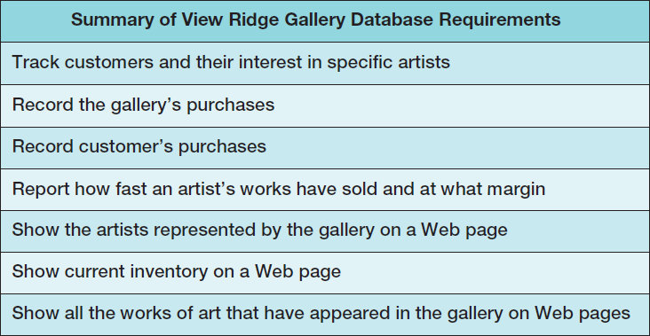
VRG Application Requirements

Slide 8
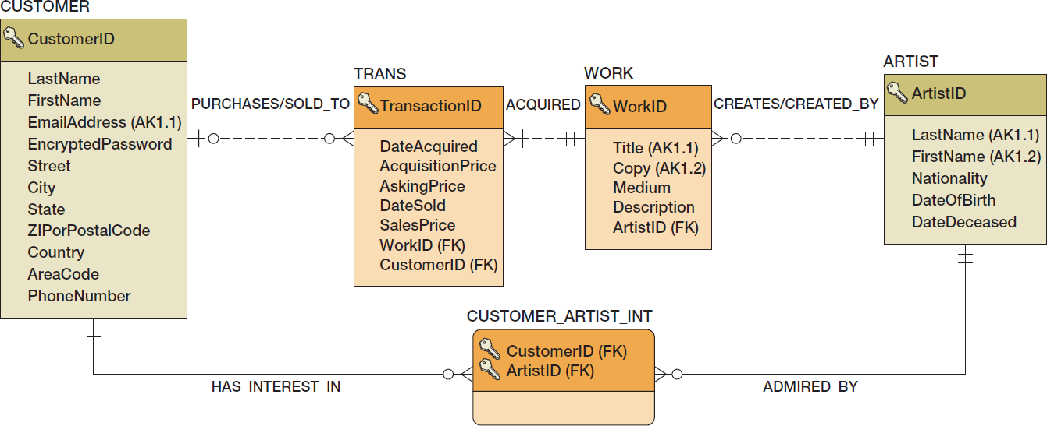
VRG Database Design

Slide 9
SQL Scripts
An SQL script is a plaintext file labeled with the .sql file extension.
An SQL script is composed of one or more SQL statements, which can include SQL script comments.
SQL script comments are lines of text that do not run when the script is executed but are used to document the purpose and contents of the script. Each comment begins with the characters /* (slash asterisk) and ends with the characters */ (asterisk slash). Alternatively, for a single line comment (or a comment at the end of a line), we use # (pound sign) at the start of the comment.

Slide 10
VRG Database Available Online
The SQL scripts to create and populate the VRG database tables are complex scripts and tedious to reproduce in their complete form.
Versions of the SQL scripts for the complete VRG database are available in the downloadable Student Files available at:
http://www.pearsonhighered.com/kroenke/
These include versions for:
Microsoft SQL Server 2014
Oracle Database 12c and Oracle Database XE
MySQL 5.6
We recommend you actually run all material in a live database!

Slide 11
Creating the VRG Database (Schema)
Use the steps previously described to create a MySQL database (schema) named VRG.
Note that MySQL will actually create this schema with the name in lowercase letters as vrg.

Slide 12
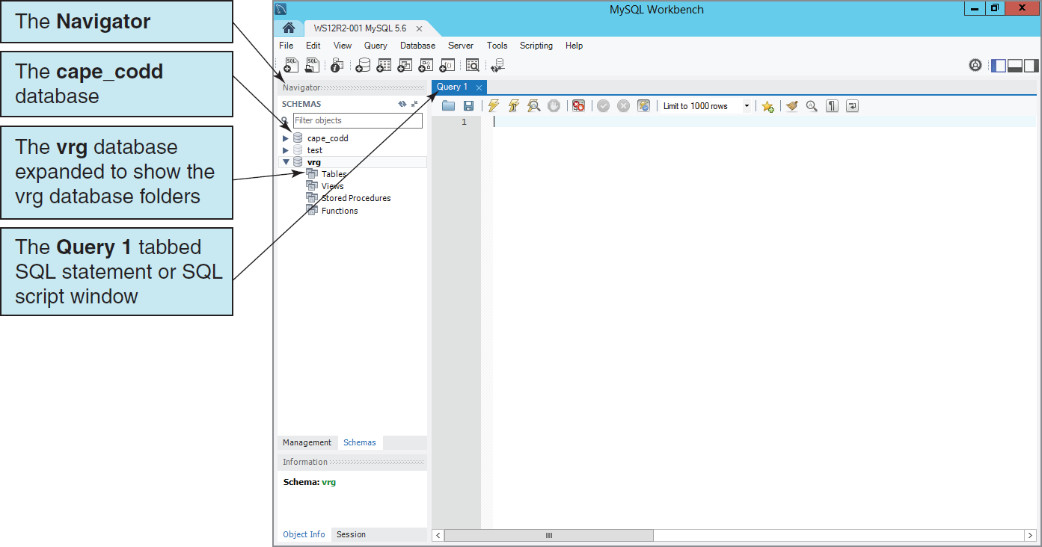
The VRG Database in the Navigator

Slide 13
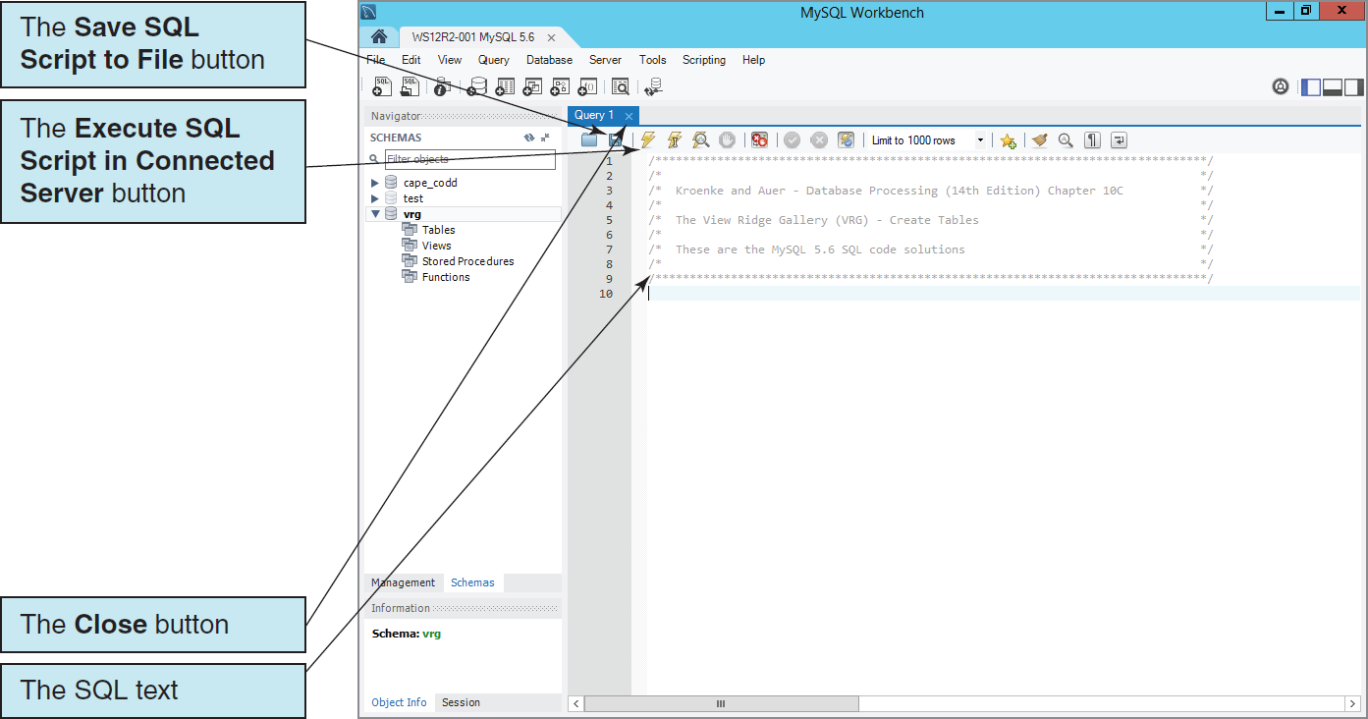
SQL Scripts The VRG Database Script in the MySQL Workbench

Slide 14
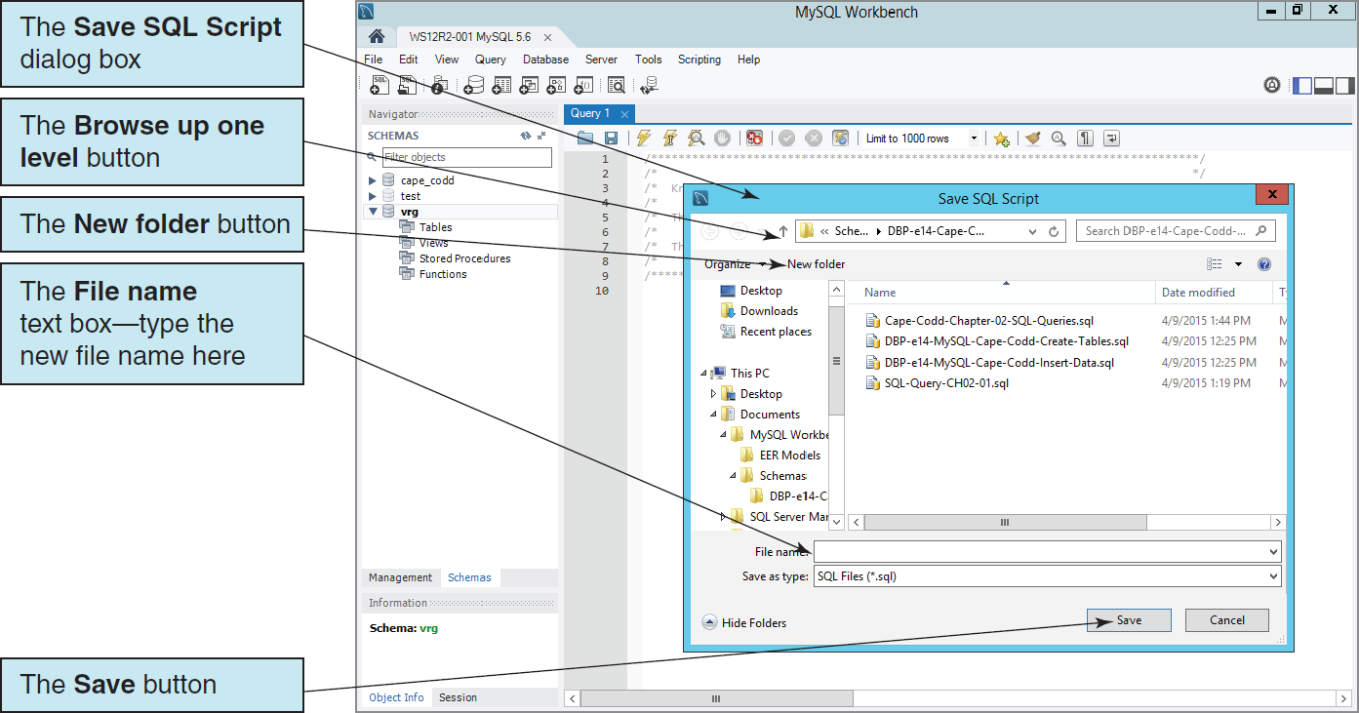
SQL Scripts Saving the SQL Script

Slide 15
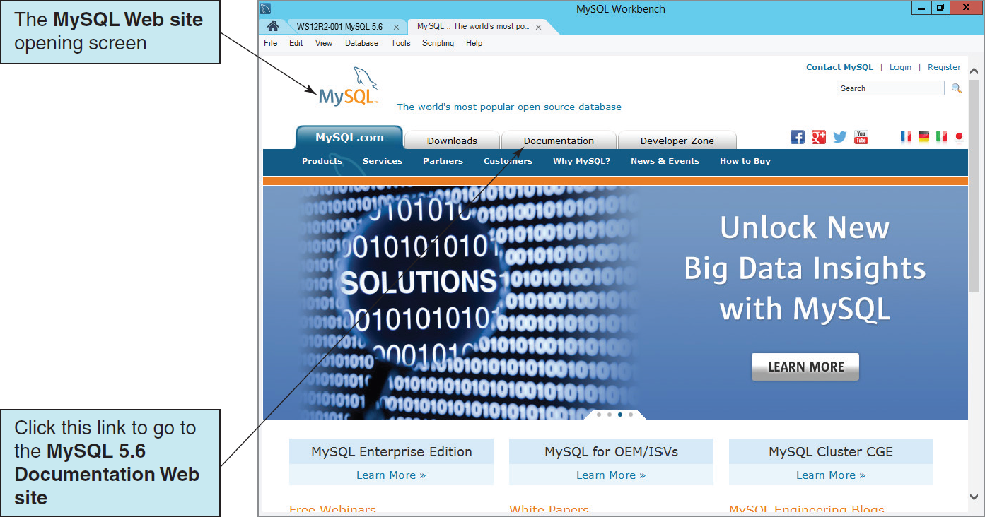
The MySQL Workbench Help Command The Help | MySQL.com Website

Slide 16
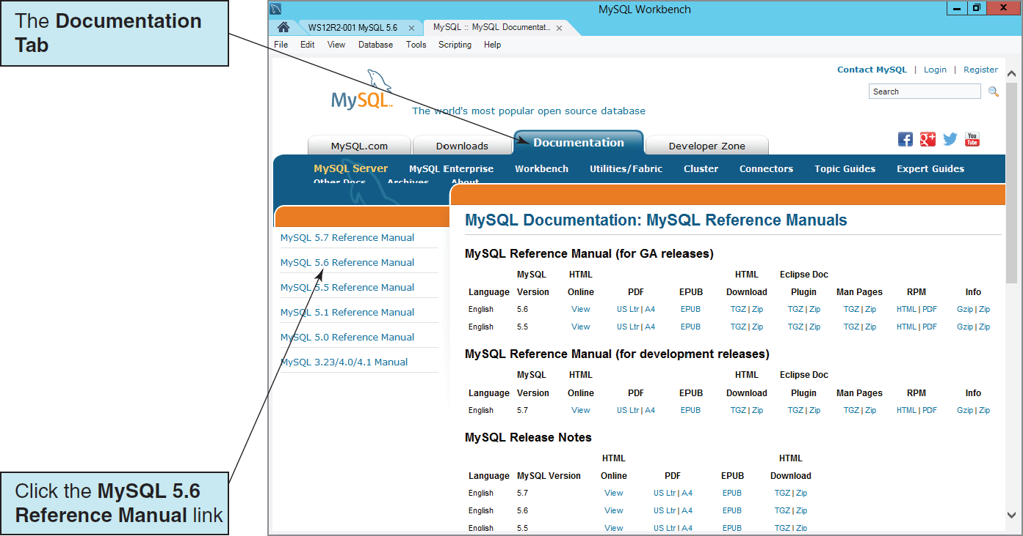
The MySQL Workbench Help Command The Documentation Tab

Slide 17
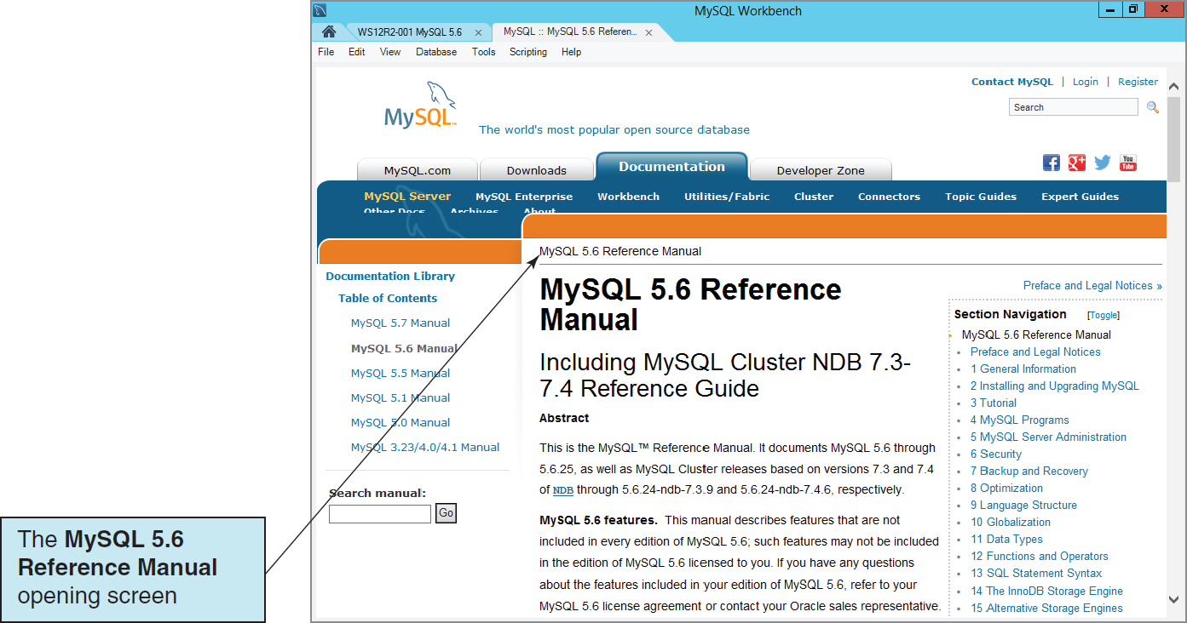
The MySQL Workbench Help Command The MySQL 5.6 Reference Manual

Slide 18
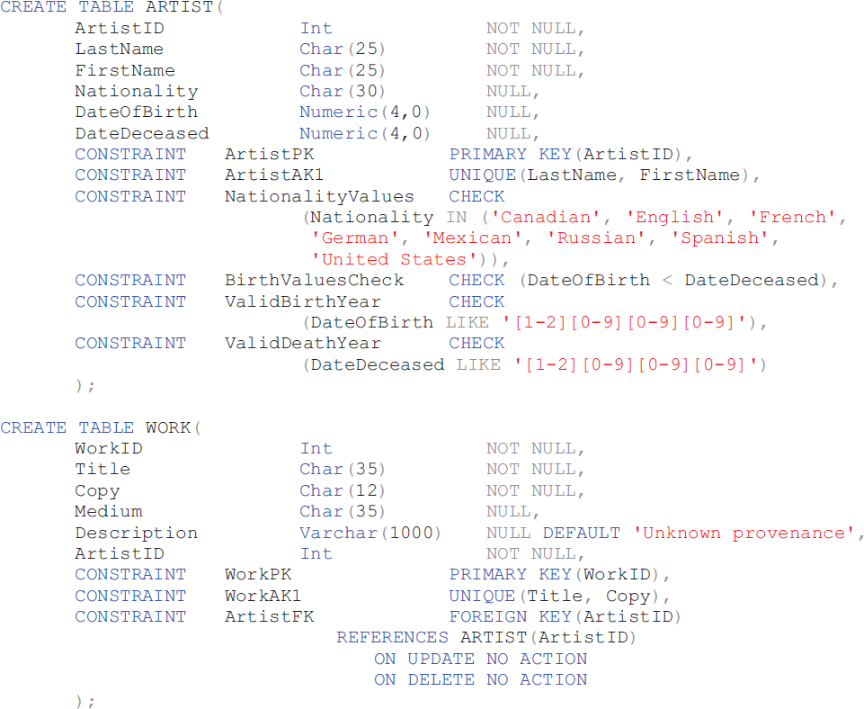
MySQL CREATE TABLE Statements for the VRG Database I

Slide 19
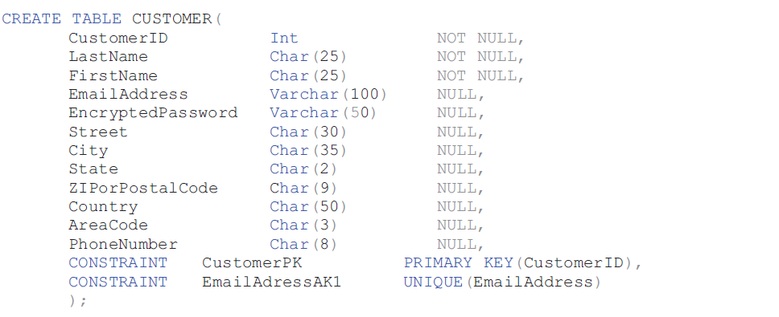
MySQL CREATE TABLE Statements for the VRG Database II

Slide 20
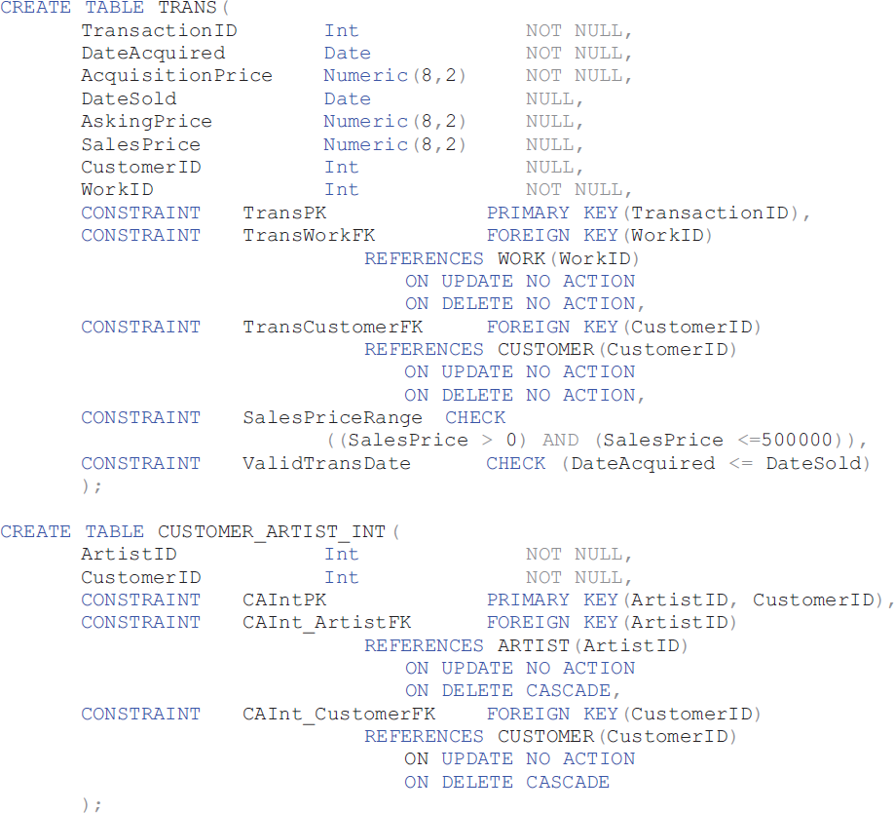
MySQL CREATE TABLE Statements for the VRG Database III

Slide 21
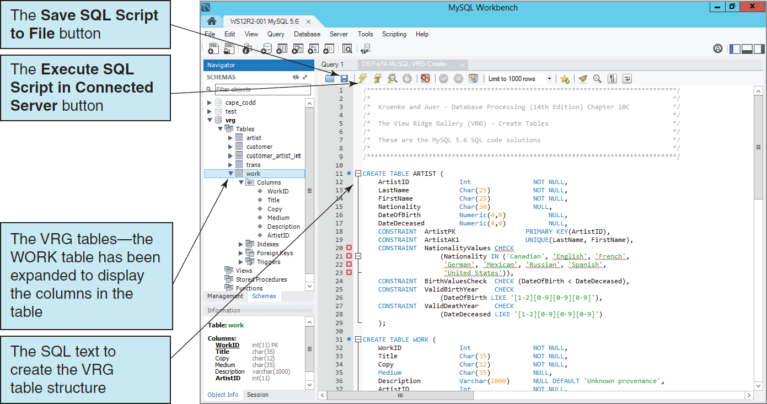
MySQL CREATE TABLE Statements: Running the Script

Slide 22
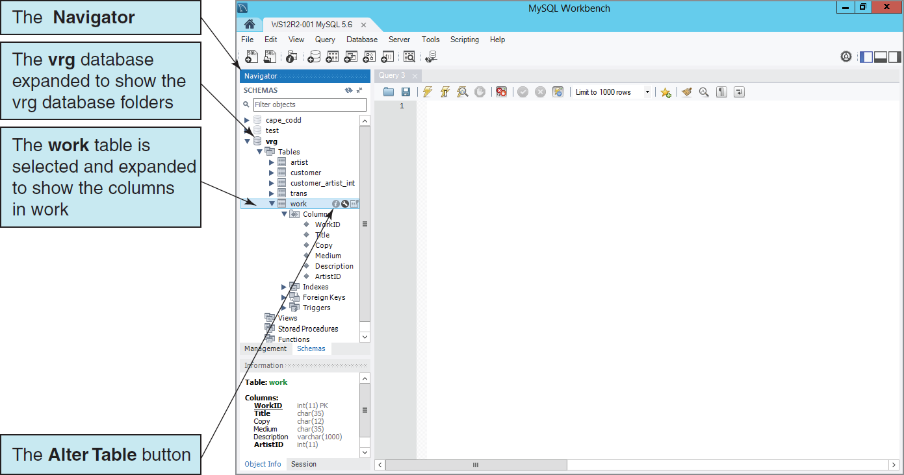
The ALTER TABLE Command: The Alter Table Button

Slide 23
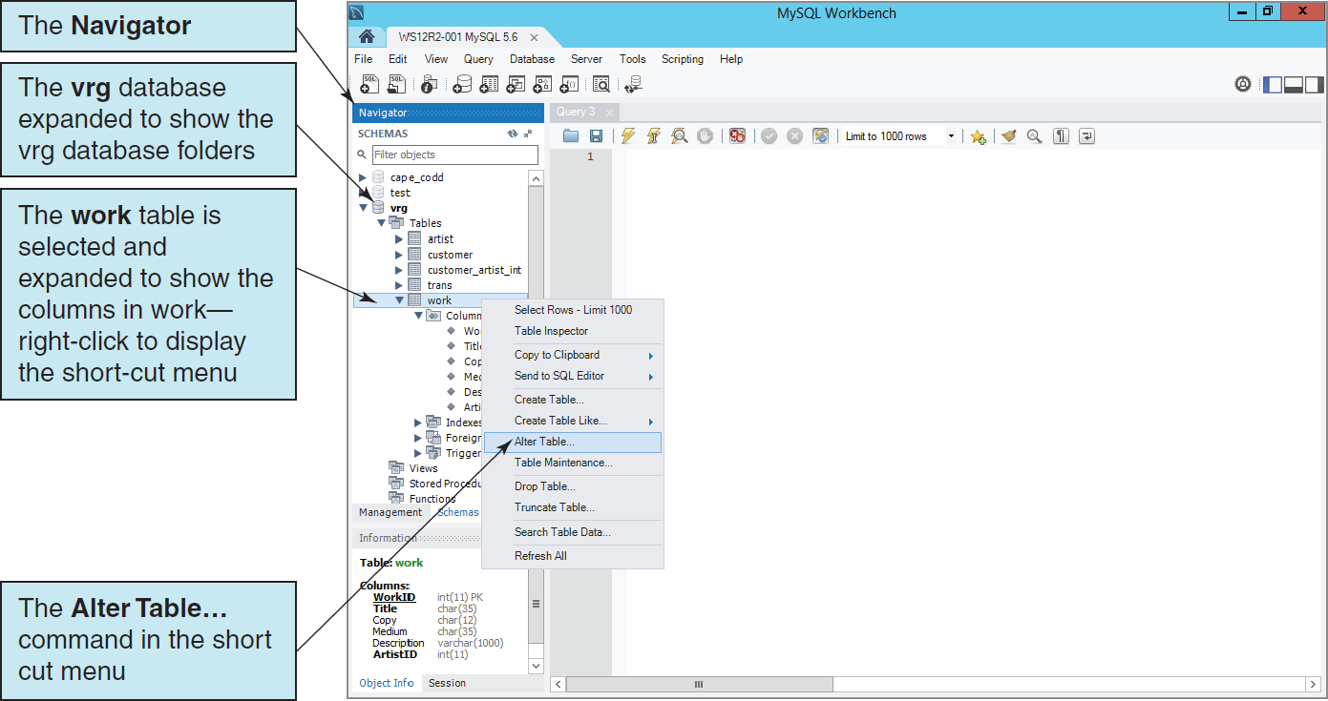
The ALTER TABLE Command: The Alter Table… Command

Slide 24
Indexes
Indexes are special data structures used to improve database performance.
MySQL Server automatically creates an index on all primary and foreign keys.
Additional indexes may be assigned on other columns that are:
Frequently used in WHERE clauses
Used for sorting data

Slide 25
Indexes
MySQL Server supports three kinds of indexes:
B-Tree
Hash
R-Tree

Slide 26
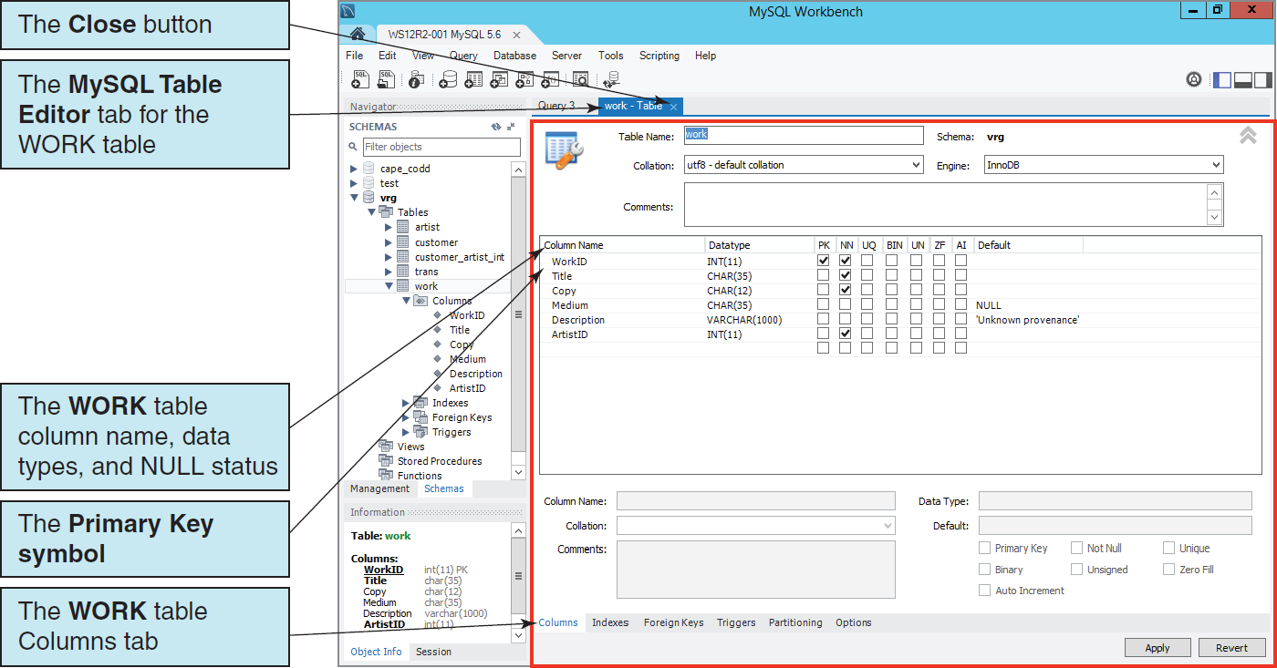
Viewing Tables: The WORK Table Columns and Column Properties

Slide 27
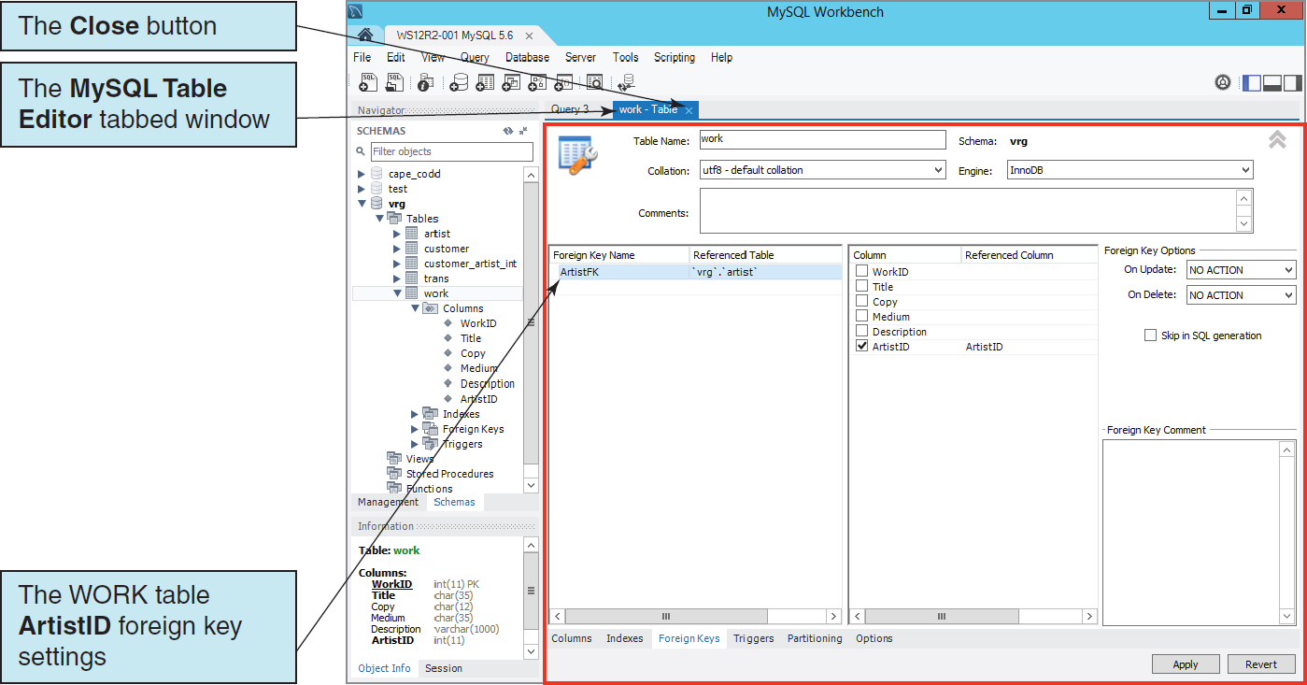
Viewing Tables: The WORK Table Foreign Key Settings

Slide 28
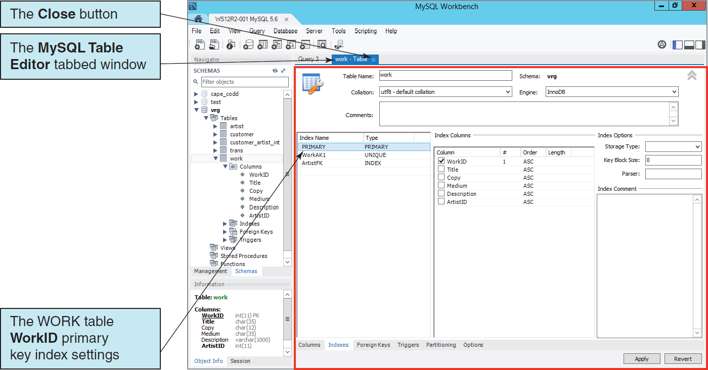
Viewing Tables: The WORK Table Primary Key Index Settings

Slide 29
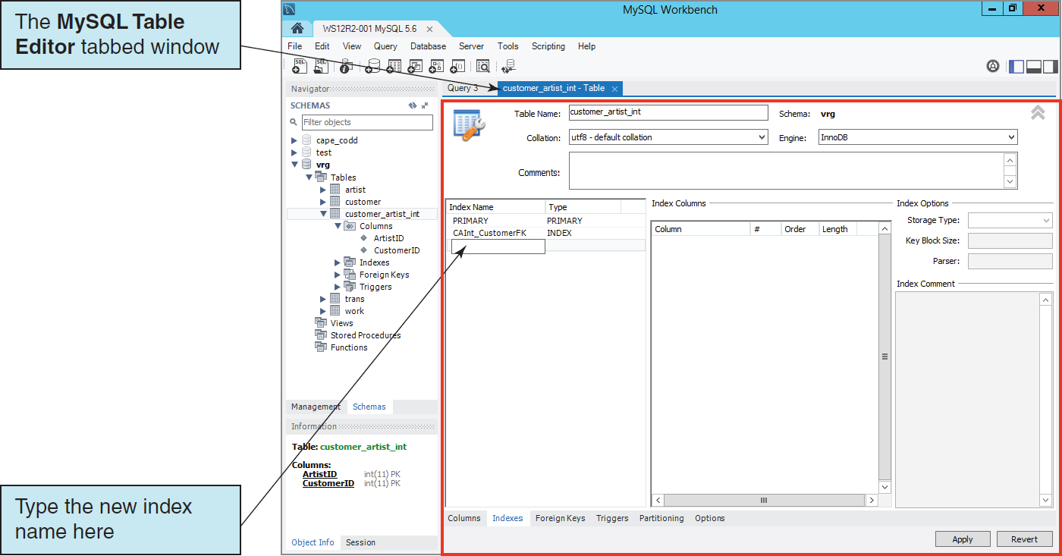
Creating an Index: The Creating an Index in theMySQL Table Editor

Slide 30
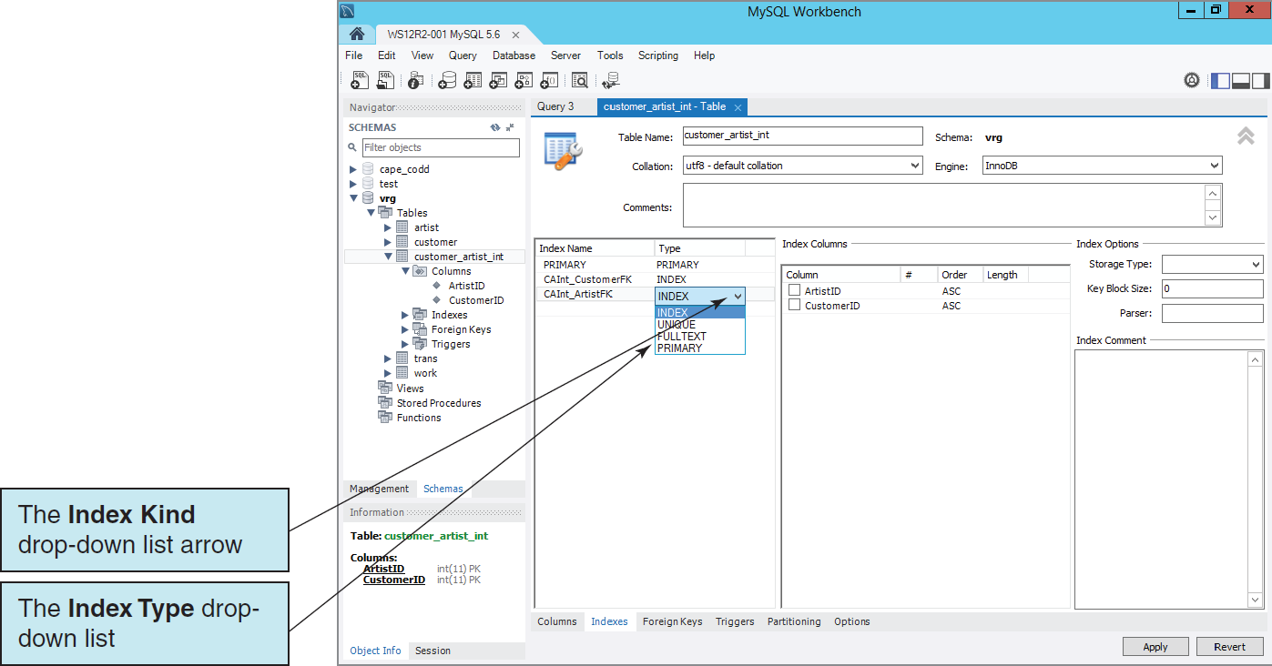
Creating an Index: Creating the CAInt_ArtistFK Index

Slide 31
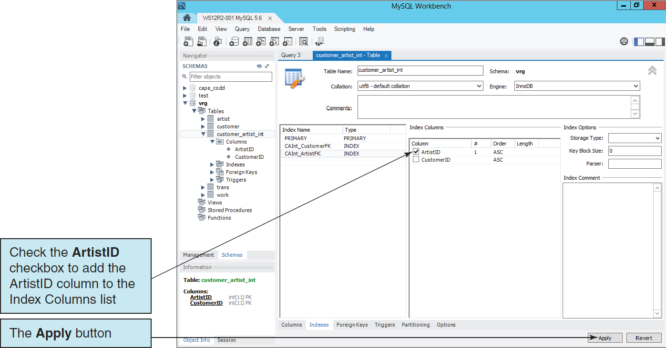
Creating an Index: Selecting the CAInt_ArtistFK Index Column

Slide 32
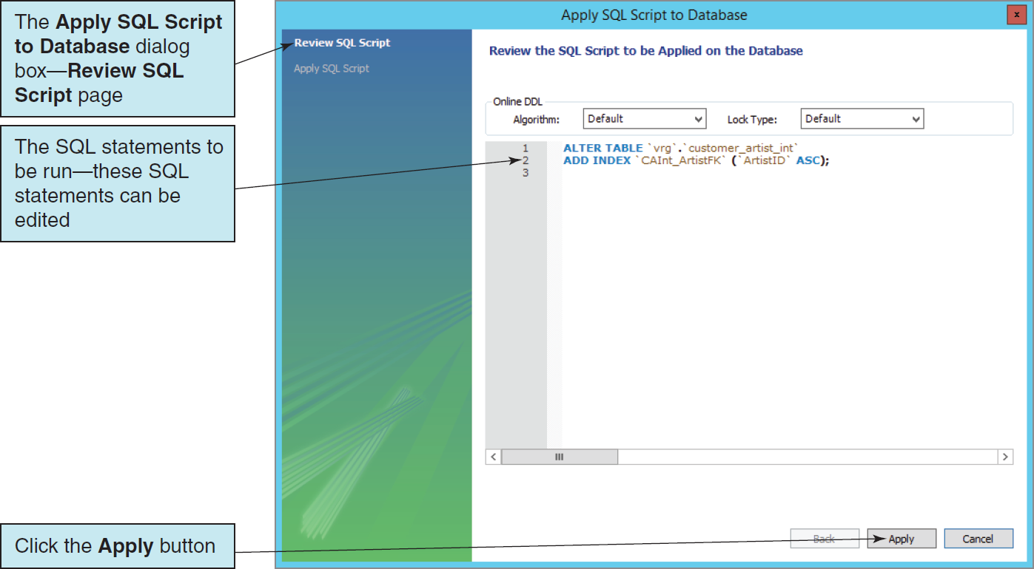
The Apply SQL Script to Database Dialog Box for the New Index Review SQL Script

Slide 33
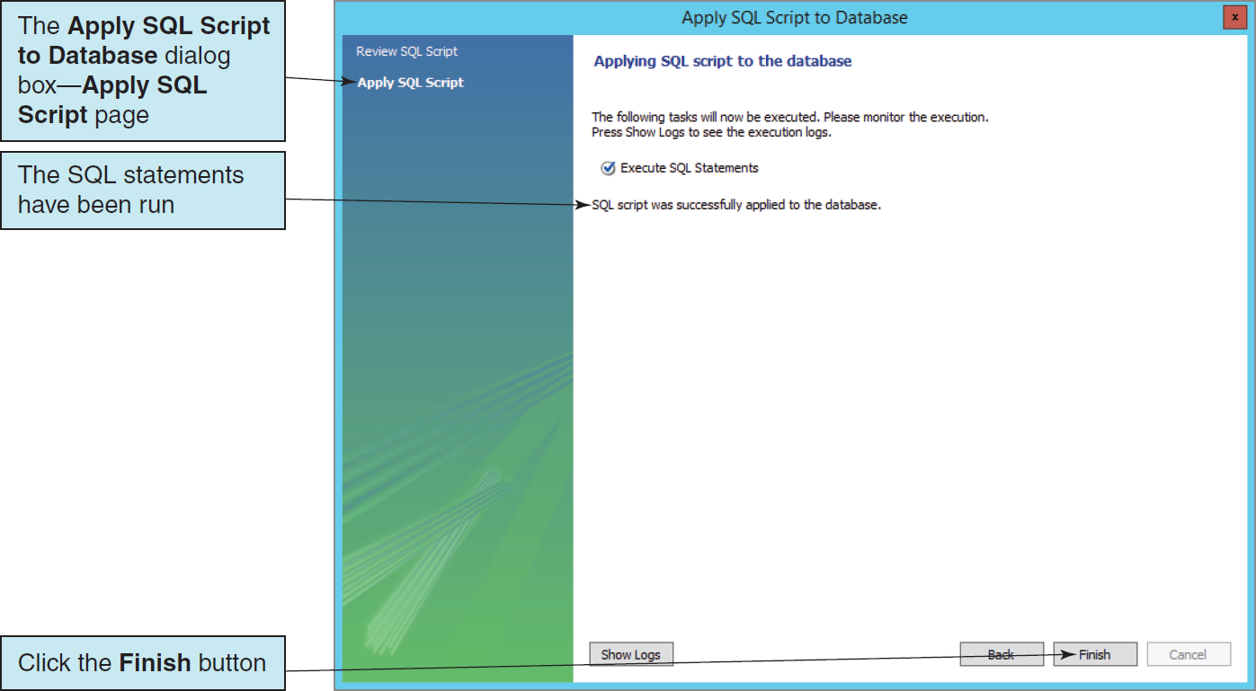
The Apply SQL Script to Database Dialog Box for the New Index Apply SQL Script

Slide 34
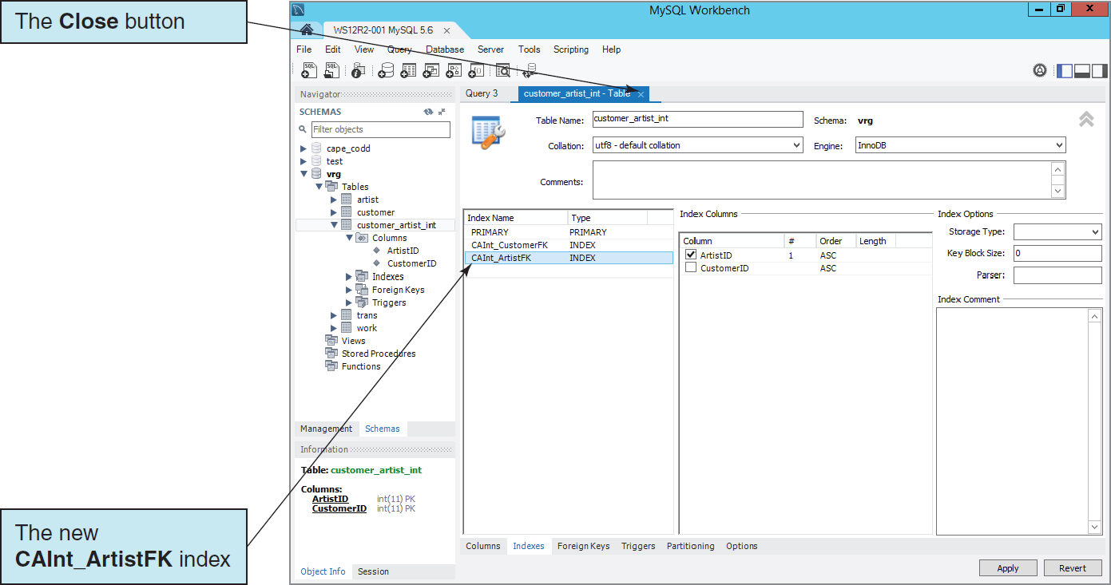
Creating an Index: The Completed CAInt_ArtistFK Index

Slide 35
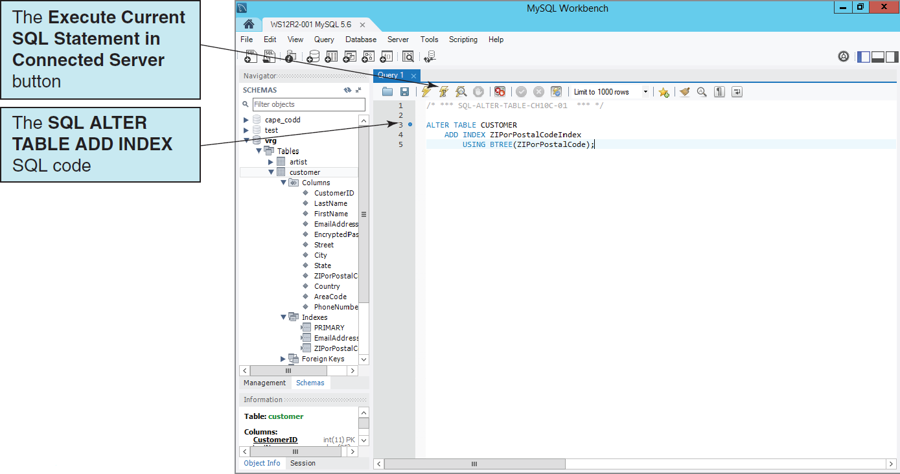
Creating an Index: The SQL ALTER TABLE ADD INDEX Command

Slide 36
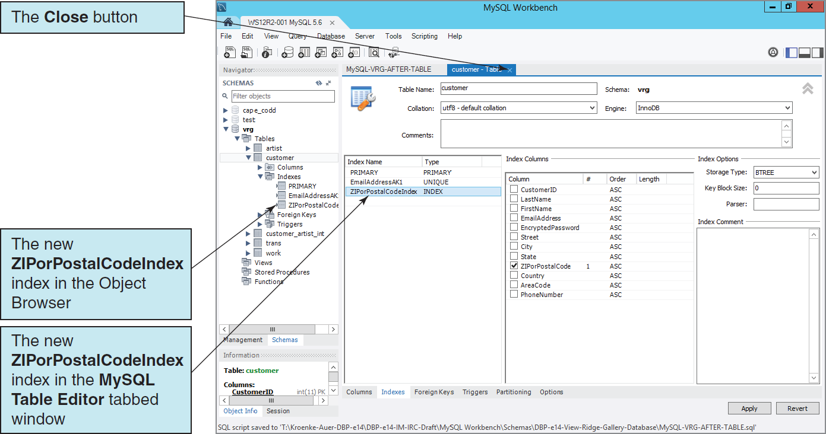
Creating an Index: The Completed ZIPorPostalCodeIndex Index

Slide 37
Populating the Tables: The AUTO_INCREMENT Keyword
The AUTO_INCREMENT keyword implements a new constraint for surrogate keys.
The increment value is always one.
The starting value is initially one, but can be modified using an ALTER TABLE statement:
ALTER TABLE TRANS AUTO_INCREMENT = 100;

Slide 38
Populating the Tables: Working with Non-continuous Primary Key Surrogate Values I
The VRG database data contains existing primary key surrogate values that are not continuous.
The VRG tables were coded without using the AUTO_INCREMENT keyword.
Insert the data, then use SQL ALTER TABLE statements to set the AUTO_INCREMENT property.
This requires dropping and reading FOREIGN KEY constraints.
Surrogate values will start at the next available data value on further data inserts.

Slide 39
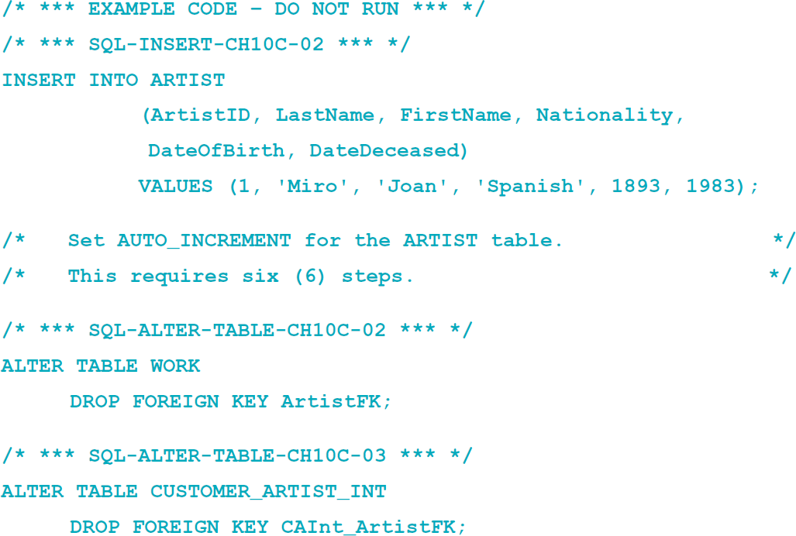
Populating the Tables: Working with Non-continuous Primary Key Surrogate Values II

Slide 40
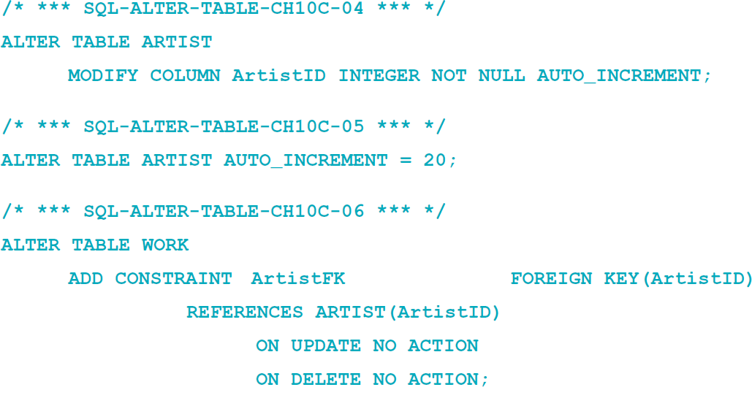
Populating the Tables: Working with Non-continuous Primary Key Surrogate Values III

Slide 41
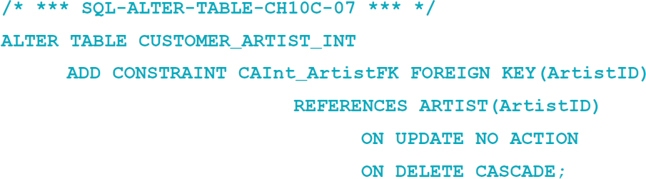
Populating the Tables: Working with Non-continuous Primary Key Surrogate Values IV
The full set of steps for the VRG database:
Is shown in Figure 10C-44
Is contained in the downloadable VRG database SQL scripts available at http://www.pearsonhighered.com/kroenke/ .

Slide 42
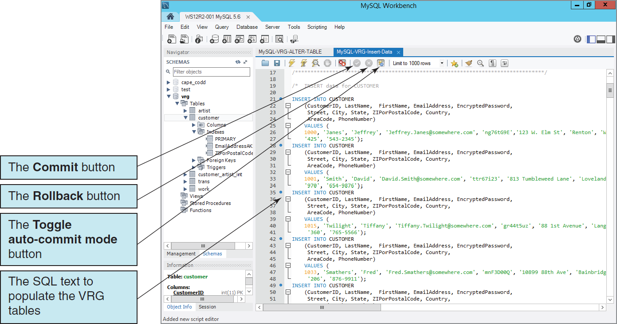
Transaction COMMIT in MySQL Autocommit is the Default
Notes:
Transaction processing statements are used with DML commands such as INSERT and UPDATE. MySQL 5.6 enables an autocommit mode (implicit COMMIT mode) by default, where a successful transaction is committed to the database automatically.
This is shown in this figure 10C-45 by the fact that the Toggle autocommit mode button is shown in color, indicating that autocommit mode is enabled. However, and as the name of the Toggle autocommit mode button
implies, autocommit mode can be disabled by using the Toggle autocommit mode button.When MySQL autocommit mode is disabled, the Commit and Rollback buttons will become functional and appear in color rather than grayed out as they are shown in this figure.
Disabling MySQL autocommit mode means that explicit transaction COMMIT actions must be done, either by (1) running a COMMIT statement or (2) clicking the Commit button after the DML transaction is completed.

Slide 43
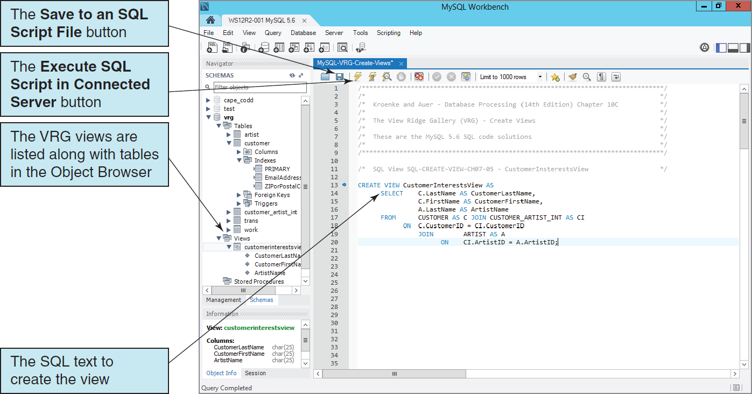
Creating an SQL View

Slide 44
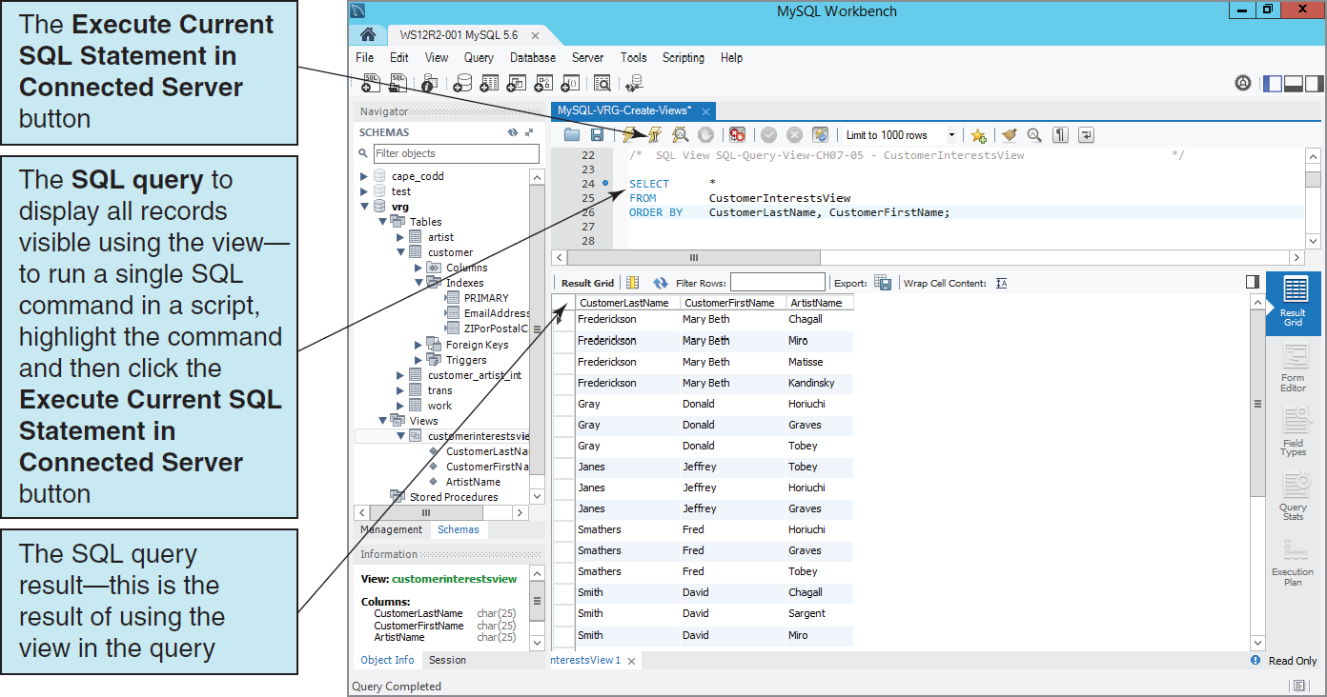
Result of Using the View CustomerInterestsView

Slide 45
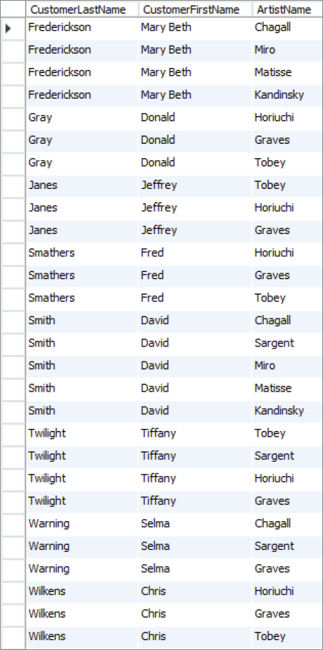
Complete Output of SQL Query on the View CustomerInterestsView

Slide 46
Importing Microsoft Excel Data MySQL for Excel
Install the MySQL for Excel Add-In
Use the MySQL Installer for Windows, or
A standalone MySQL for Excel installer.
The POSTCARDS worksheet is included in the downloadable Student Files available at: http://www.pearsonhighered.com/kroenke/

Slide 47
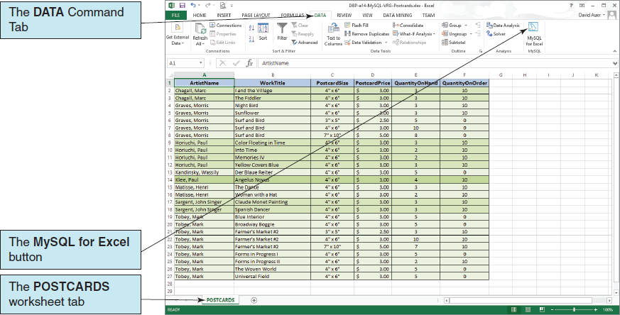
Importing Microsoft Excel Data The View Ridge Gallery POSTCARD Worksheet

Slide 48
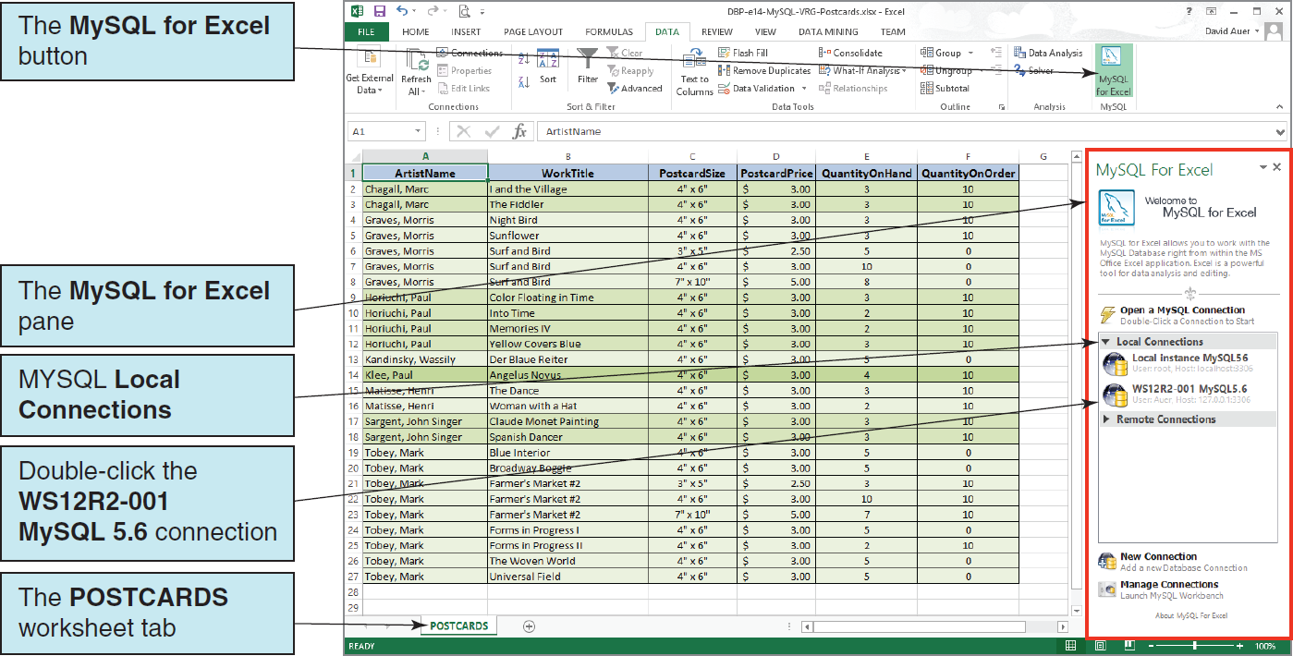
MySQL for Excel The Open a MySQL Connection Pane

Slide 49
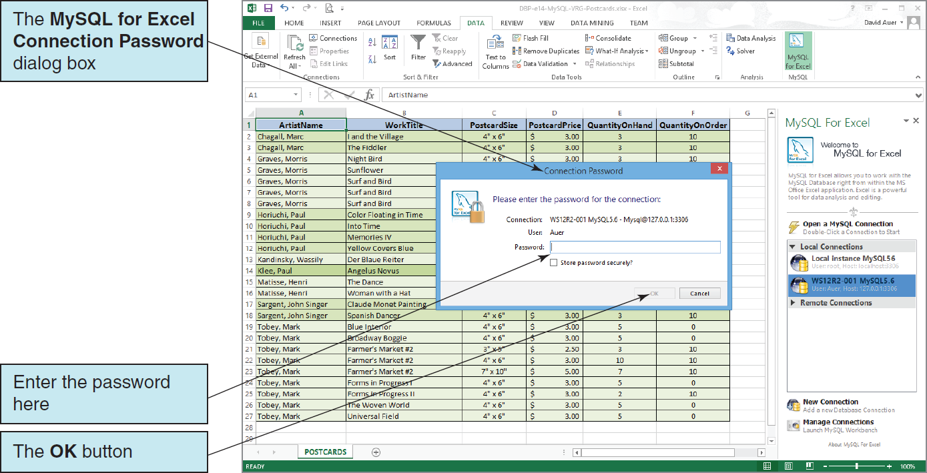
MySQL for Excel The Connection Password Dialog Box

Slide 50
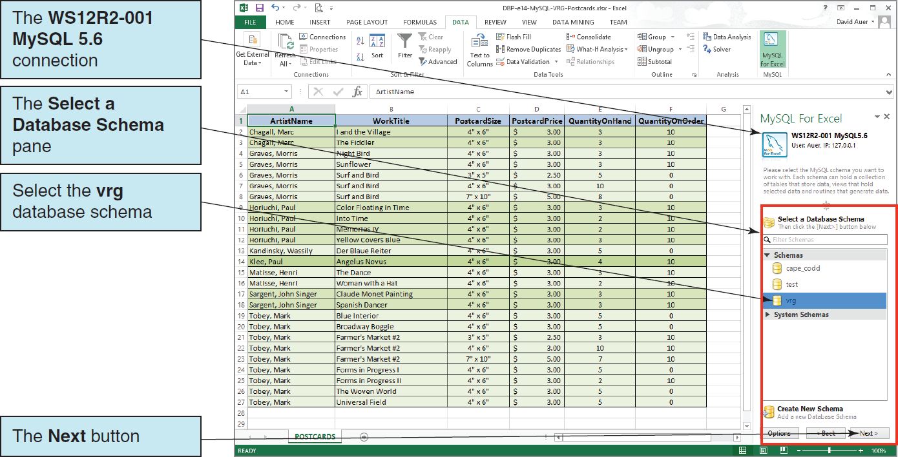
MySQL for Excel The Select a Database Schema Pane

Slide 51
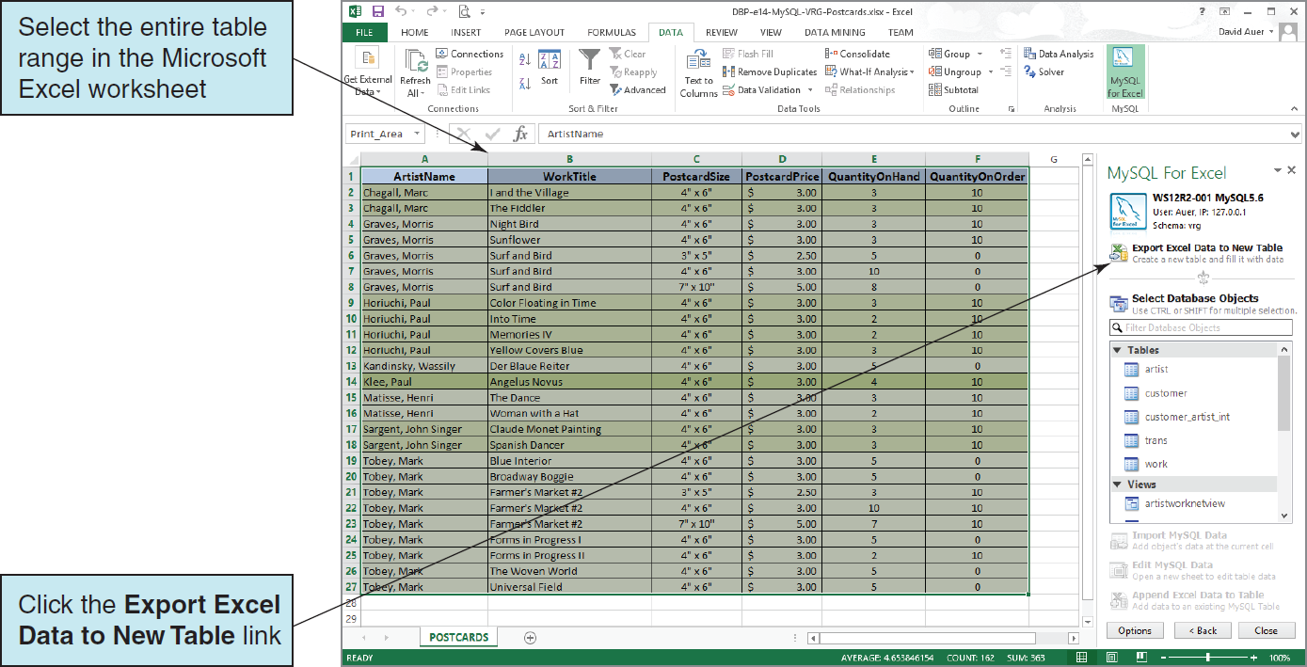
MySQL for Excel The Export Excel Database to New Table Button

Slide 52
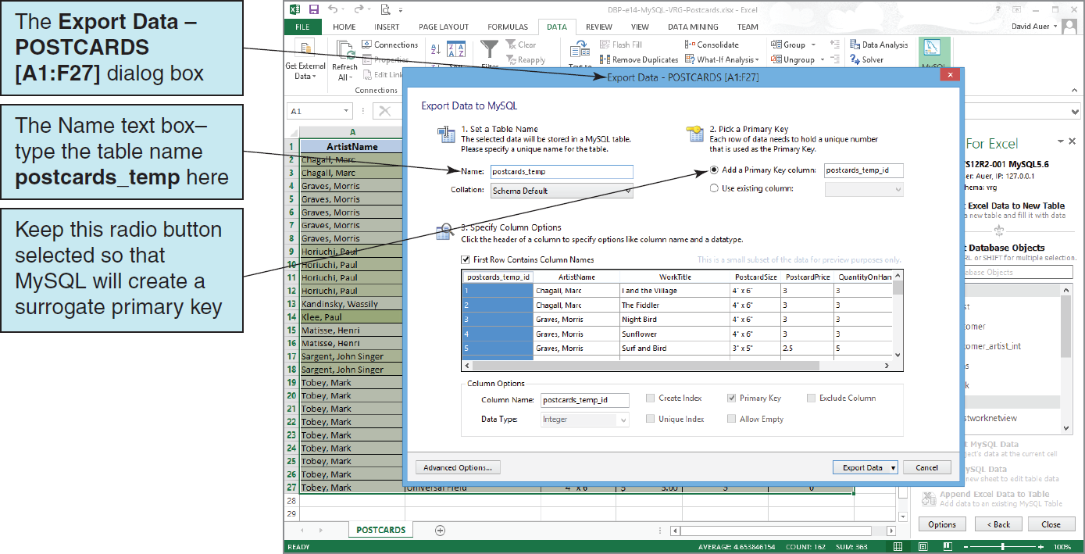
MySQL for Excel The Export Data – POSTCARDS [A1:F27] Dialog Box

Slide 53
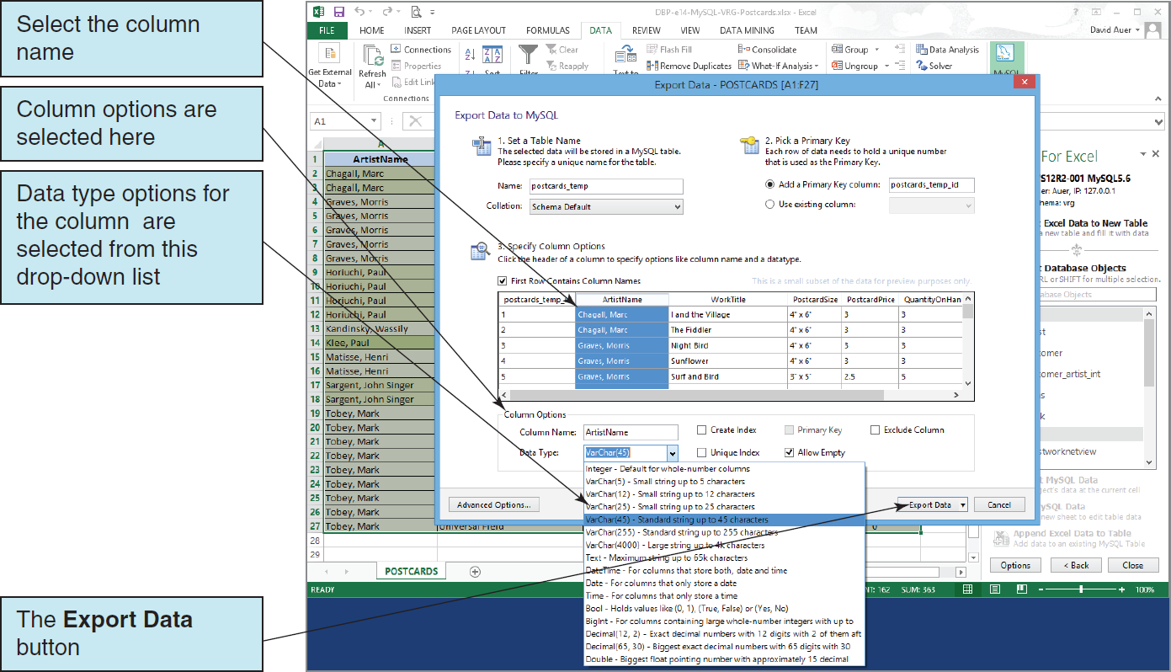
MySQL for Excel Column Options

Slide 54
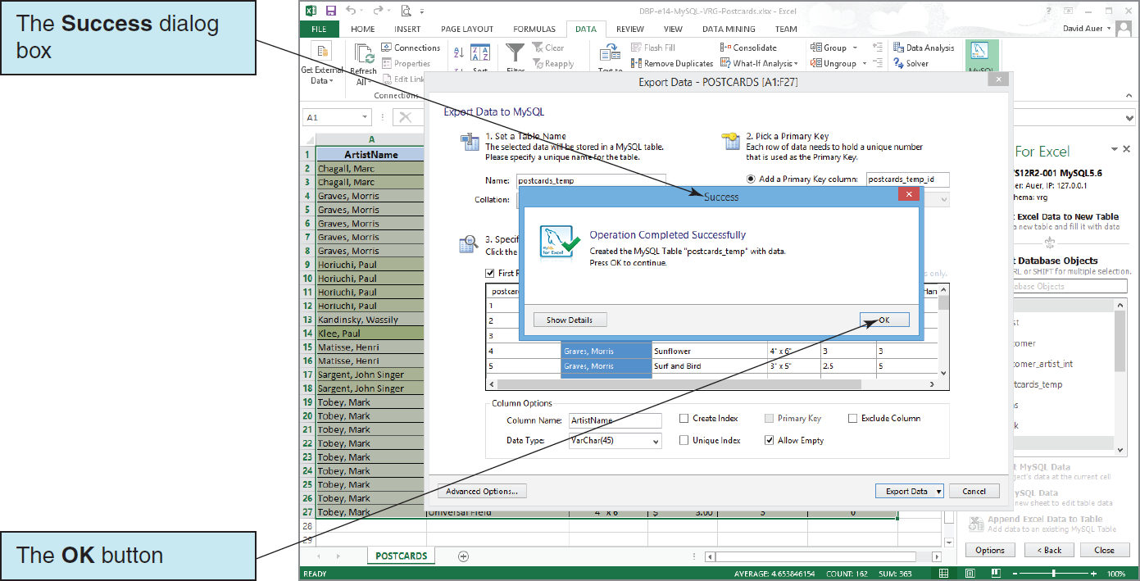
MySQL for Excel The Success Dialog Box

Slide 55
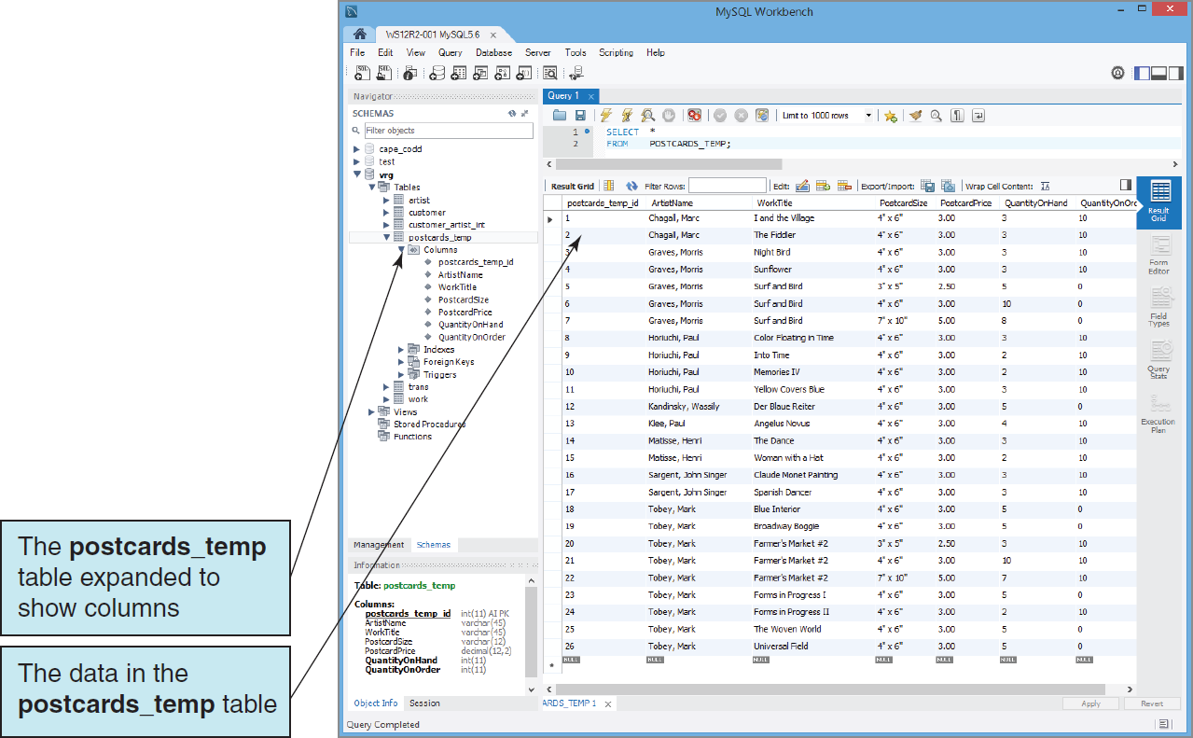
The POSTCARDS_TEMP Data in the VRG Database

Slide 56
Application Logic I
MySQL Server implements the SQL/Persistent Stored Modules (SQL/PSM) standard, but does have a special name for the MySQL variant of SQL—it is just called SQL!

Slide 57
Application Logic II
MySQL Server database application can be processed using:
Programming languages to invoke SQL Server DBMS commands
The MySQL Command Line utility to invoke database commands stored in .sql files
The MySQL Query Browser to invoke database commands stored in .sql files
Stored procedures
Triggers

Slide 58
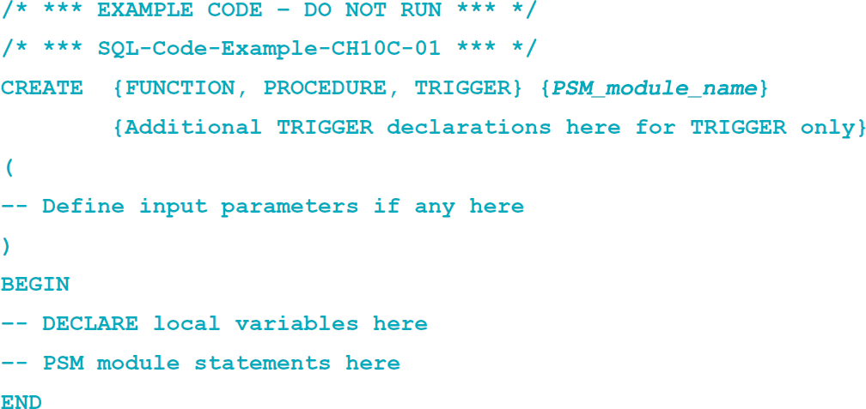
Application Logic: Basic MySQL SQL/PSM Structure
Notes:
Note the use of the BEGIN . . . END keywords, which defines a block of Transact-SQL statements so more than one statement can be executed, to contain all procedural statements in the user-defined function, stored procedure, or trigger.

Slide 59
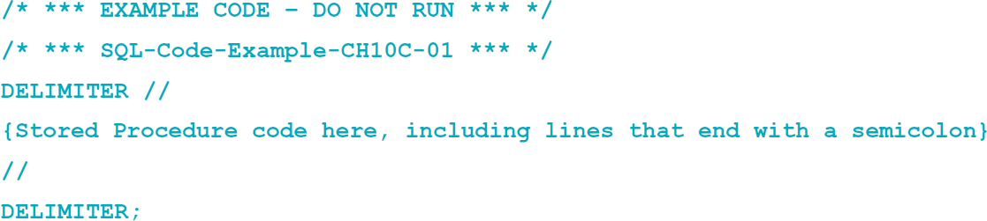
Application Logic: MySQL SQL/PSM Statement Delimiters
MySQL must use a delimiter other than the SQL semicolon(;) when creating stored procedures and triggers:
This is a semicolon (;)
Notes:
SQL statements in procedures and triggers are written with a delimiter, the same semicolon (;) required in nonprocedural SQL statements.
However, when working with stored procedures in a command-line editor, MYSQL needs to use a different delimiter to allow input of semicolons within the procedure.
For consistency, we will continue to use the semicolons for SQL statements but will switch to the delimiter // (slash slash) for creating stored procedures.

Slide 60
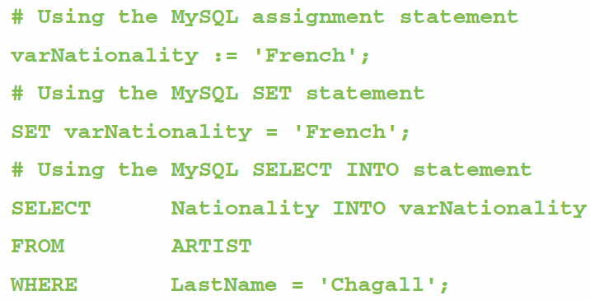
Application Logic: Parameters and Variables
A parameter is a value passed to a stored procedure.
A variable is a value used within the stored procedure.

Slide 61
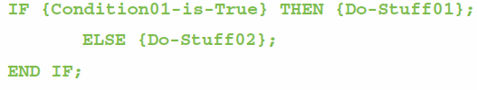
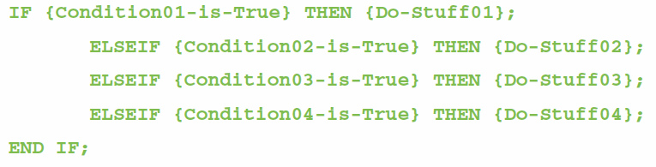
Application Logic: MySQL Control of Flow Statements I
IF…THEN…ELSE…END IF
IF…ELSEIF…END IF

Slide 62
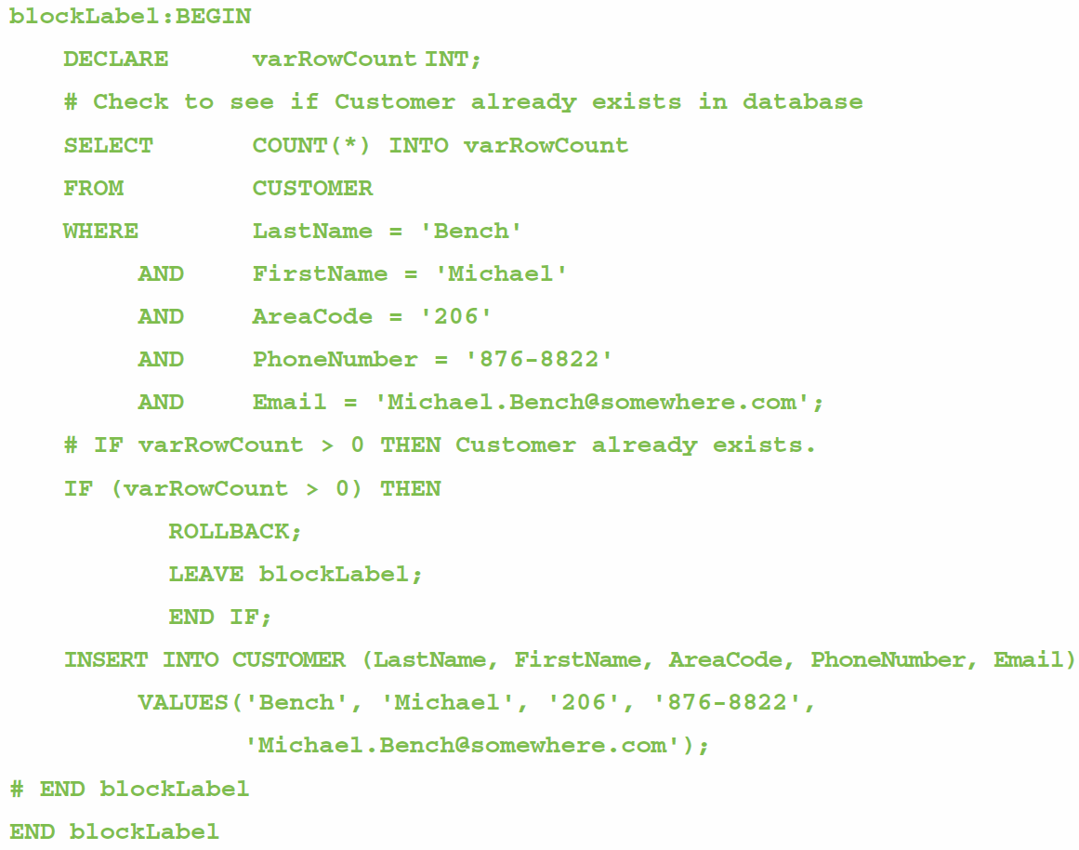
Application Logic: MySQL Control of Flow Statements II
BEGIN…END
Block Labels
ROLLBACK
LEAVE

Slide 63
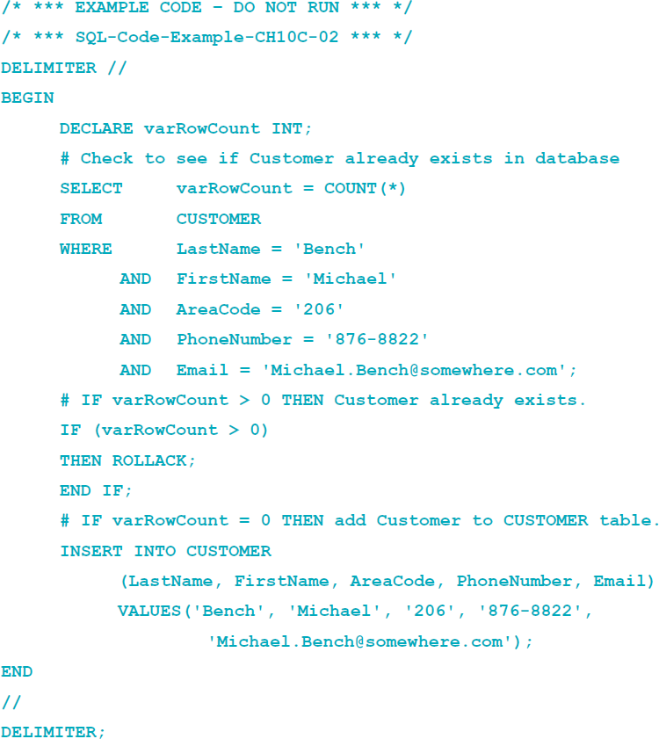
Application Logic: Example with Delimiter

Slide 64
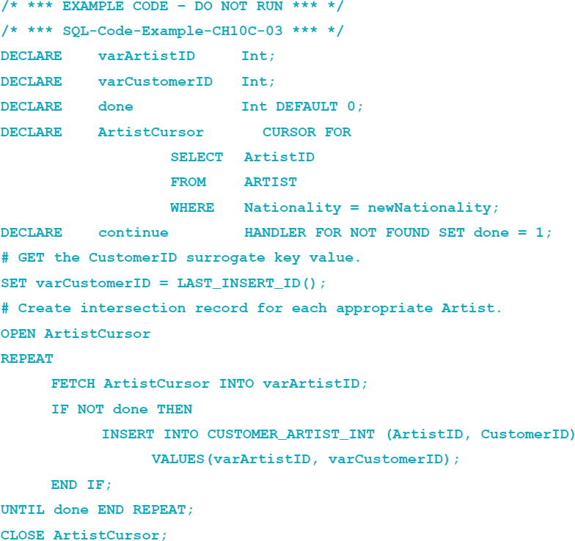
Application Logic: MySQL Cursor Statements
DECLARE
OPEN
FETCH
CLOSE

Slide 65
Application Logic: MySQL Output Statements
MySQL does not have output statements such as PRINT.
An SQL SELECT query can be used to provide limited output.

Slide 66
SQL/Persistent Stored Modules (SSL/PSM)
SQL/Persistent Stored Modules (SQL/PSM) is an ANSI/ISO standard for embedding procedural programming functionality into SQL.
Each DBMS product implements SQL/PSM in a different way, with some closer to the standard than others.
Microsoft SQL Server 2014 calls its version Transact-SQL (T-SQL).
Oracle Database calls its variant Procedural Language/SQL (PL/SQL).
MySQL 5.6 implements SQL/PSM, but has no special name for its variant of SQL.

Slide 67
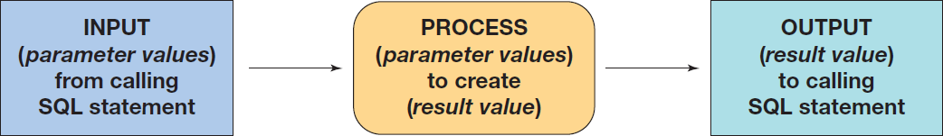
User-Defined Functions
A user-defined function (stored function) is a stored set of SQL statements that:
is called by name from another SQL statement
may have input parameters passed to it by the calling SQL statement, and
returns an output value to the SQL statement that called the function.

Slide 68

User-Defined Functions The FirstNameFirst Function

Slide 69

User-Defined Functions The FirstNameFirst Function
Using the FirstNameFirst function:

Slide 70

User-Defined Functions The FirstNameFirst Function
FirstNameFirst function results:

Slide 71
User-Defined Functions Additional Character String Functions
The LOCATE function returns the numeric position of a character:
The SUBSTRING function returns a specified subset of the characters in a character string:

Slide 72

User-Defined Functions The GetLastNameCommaSeparated Function I

Slide 73

User-Defined Functions The GetLastNameCommaSeparated Function II
Using the GetLastNameCommaSeparted function:

Slide 74

User-Defined Functions The GetLastNameCommaSeparated Function Results

Slide 75


Altering the POSTCARDS_TEMP table
To run these UPDATE statements, we must change the safe updates setting

Slide 76

Safe Updates The Edit | Preferences Command

Slide 77

Safe Updates Allowing UPDATES without an SQL WHERE Clause

Slide 78
Stored Procedures
A stored procedure is a compiled program stored within the database.
Stored procedures are programs that can:
Have parameters.
Invoke other procedures and functions.
Return values.
Raise exceptions.
Creating stored procedures:
Write a stored procedure in a text file and process the commands using the MySQL Query Browser

Slide 79


Slide 80


Slide 81

Running Stored Procedures Running the InsertCustomerAndInterests Stored Procedure

Slide 82

Running Stored Procedures The CustomerInterestsView Results

Slide 83
Triggers
An SQL Server trigger is invoked when a specified database activity occurs.
Triggers can be used to:
Enforce business rules.
Set complex default values.
Update views.
Implement referential integrity actions.
MySQL Server only supports BEFORE and AFTER triggers.
Without the INSTEAD OF trigger, triggers on SQL views are not supported.
MySQL trigger support is very limited, and triggers may not be used to:
Make a change in the table that fired the trigger.
Return an output value—triggers can use the LEAVE keyword to exit without returning a value.
Make implicit or explicit ROLLBACKs of COMMITs.

Slide 84

Triggers Comparison

Slide 85

Adding the PRICELIST Table

Slide 86


Slide 87


Slide 88

Running Triggers Results for the TRANS_AfterInsertSetAskingPrice Trigger

Slide 89

Displaying MySQL Triggers With the SHOW TRIGGERS Command

Slide 90

Displaying MySQL Triggers With the Triggers Tab in the MySQL Table Editor

Slide 91
Concurrency Control
One factor determines the concurrency control behavior of MySQL:
Transaction isolation level
Lock types include:
Record locks—a lock on the index record
Gap locks—generally, a lock on the unused index numbers between index records (see the MySQL documentation)
Next-Key locks—a combined record lock on the index record together with a gap lock on the unused index numbers before the index record itself

Slide 92

MySQL Concurrency Options

Slide 93

MySQL Security Model

Slide 94

MySQL Server Administration The MySQL Workbench MANGEMENT, INSTANCE and PERFORMANCE Page Links

Slide 95

MySQL Server Administration The Administration—Server Status Window

Slide 96

MySQL Server Administration The Administration—User and Privileges Window

Slide 97

MySQL Logins and Privileges The Default User Data

Slide 98

MySQL Logins and Privileges Creating the VRG-User Login

Slide 99

MySQL Logins and Privileges The VRG-User Login in User Accounts

Slide 100

MySQL Logins and Privileges Assigning Administrative Roles

Slide 101

MySQL Logins and Privileges Assigning Schema Privileges

Slide 102

MySQL Logins and Privileges Selecting the Schema

Slide 103

MySQL Logins and Privileges Default Host and Schema Privileges

Slide 104

MySQL Logins and Privileges Selected Host and Schema Privileges

Slide 105

MySQL Logins and Privileges Assigned Host and Schema Privileges

Slide 106

MySQL Backup

Slide 107

MySQL Restore

Slide 108
David Kroenke and David Auer Database Processing Fundamentals, Design, and Implementation (14th Edition)
End of Presentation:
Chapter Ten C Part 2

Slide 109

All rights reserved. No part of this publication may be reproduced, stored in a retrieval system, or transmitted, in any form or by any means, electronic, mechanical, photocopying, recording, or otherwise, without the prior written permission of the publisher. Printed in the United States of America.

